Slide 1
A. D. Alexandrov and the
Birth of the Theory of Tight Surfaces
Thomas F. Banchoff

Slide 2
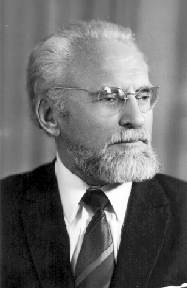
Aleksander Danilovich Alexandrov

Slide 3
А. Д. Александров
Об одном классе замкнутых поверхностей
Мат. Сборчик 46 (1938) 69-77

Slide 4
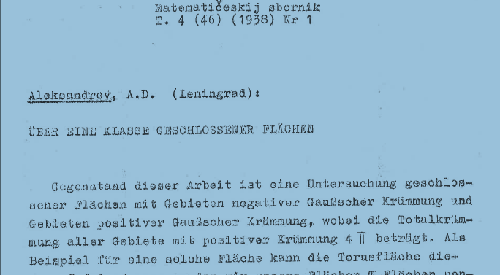

Slide 5
Minimal Total Absolute Curvature
Alexandrov: A twice continuously differentiable closed surface is a T-Surface (surface of Torus type) if it satisfies the following conditions:
The region of positive curvature is separated from the region of negative curvature by piecewise smooth curves.
The only points where K = 0 lie on these curves.
The Total Curvature of the region with K > 0 is 4π.

Slide 6
Alexandrov Theorems
The region of positive curvature on a T-surface is a connected subset of a convex surface. The boundary curves are closed convex curves lying in tangent planes.
If two real analytic T-surfaces are isometric, they are congruent (possibly by reflection).
Each real analytic T-surface is rigid.

Slide 7
Louis Nirenberg 1963
Rigidity of a Class of Closed Surfaces
Non-Linear Problems, Univ. of Wisconsin Press
Rigidity of Differentiable T-Surfaces of Class C⁵ plus Differential Equations Conditions
Conditions: At points where K is zero, the gradient of K is not zero (so negative curvature components are tubes). Each tube contains at most one closed asymptotic curve.

Slide 8

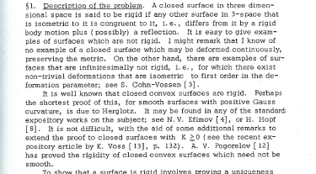

Slide 9
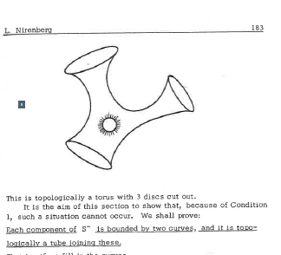

Slide 10
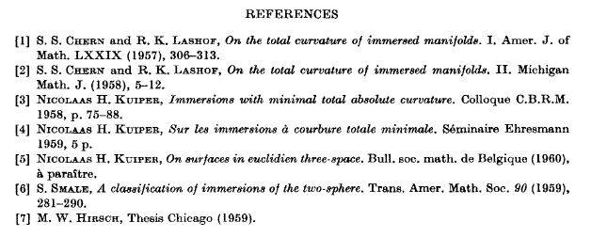

Slide 11
Minimal Total Absolute Curvature
Alexandrov: The integral of K over the region where K > 0 is 4π. Almost every height function has one maximum.
Nirenberg: Every local support plane is global.

Slide 12
Fenchel’s Theorem
Theorem of Werner Fenchel (1929): The total curvature of a space curve is greater than or equal to 2π with equality only for a convex curve.
Proof of Konrad Voss (1955): The total curvature of a space curve is the one half the total absolute Gaussian curvature of a circular tube around the curve.

Slide 13
Fary-Milnor Knot Theorem
Theorem (Istvan Fary 1949):
The total curvature of a knotted closed space curve is greater than or equal to 4π (using average projection to planes).
Theorem (John Milnor 1950):
The total curvature of a knotted closed space curve is greater than 4π (using average projection to lines).

Slide 14
Shiing-Shen Chern and Richard Lashof
On the Total Curvature of Immersed Submanifolds,
American Journal of Mathematics, 1957
On the Total Curvature of Immersed Submanifolds II
Michigan Journal of Mathematics, 1958
Theorem: If all height functions on a sphere have the minimal number of critical points, then the sphere is the boundary of a convex body.

Slide 15
Minimal Total Absloute Curvature
Alexandrov: The integral of K over the regioin where K > 0 is 4π. Almost every height function has one max.
Nirenberg: Every local support plane is global.
Chern-Lashof: The integral of the absolute value of the Lipschitz-Killing curvature of the tube about a submanifold is minimal.
Every height function has the minimum
number of critical points on the submanifold.

Slide 16
Nicolaas Kuiper
Immersions with Minimal Total Absolute Curvature, Colloque Bruxelles, 1958
Sur les immersions a courbure totale minimale
Institut Henri Poincaré, 1960
On Surfaces in Euclidean 3-Space
Bull. Soc. Math. Belg.,1960
On Convex Immersions of non-Orientable Closed Surfaces in E³, Comm. Math. Helv. 1961
On Convex Maps, Nieuw Archief voor Wisk,. 1962

Slide 17
Minimal Total Absolute Curvature
Alexandrov: The integral of K over the region where K > 0 is 4π. Almost every height function has one maximum.
Nirenberg: Every local support plane is global.
Chern-Lashof: The integral of the absolute value of the curvature of the tube is minimal.
Every height function has the minimum
number of critical points on the submanifold.
Kuiper: The integral of |K| over a surface is minimal, equal to 2π(4 - Euler characteristic).

Slide 18
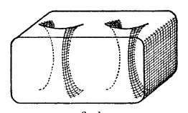
Tight Two-Holed Torus

Slide 19
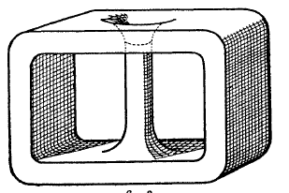
Tight Klein Bottle with One Handle

Slide 20
Kuiper Theorems
Any orientable surface has a tight smooth embedding into 3-space.
Any non-orientable surface with Euler characteristic less than -1 has a tight smoothimmersion into 3-space.
The real projective plane and the Klein bottle can’t be tightly immersed into 3-space.
The case of characteristic -1 is open.

Slide 21
Nicolaas Kuiper, William Pohl
Tight Topological Embeddings
of the Real Projective Plane in E⁵
Inventiones Mathematicae 1977
Theorem: The only tight topological embeddings of RP² into E⁵ are the Analytic Veronese surface and RP²₆.

Slide 22

Steiner’s Roman Surface

Slide 23
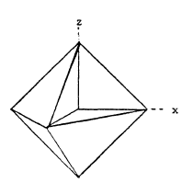

Slide 24
Minimal Total Absolute Curvature
Alexandrov: The integral of K over the regioin where K > 0 is 4pi. Almost every height function has one max.
Nirenberg: Every local support plane is global.
Chern-Lashof: The integral of the absolute value of the curvature of the tube is minimal.
Every height function has the minimum
number of critical points on the submanifold.
Kuiper: The integral of |K| is minimal.
Banchoff: Any plane cuts M into at most two pieces, so the intersection with any half-space is connected.

Slide 25
The Two Piece Property (TPP)
A set X in Euclidean space has the TPP if every hyperplane H separates X into at most two pieces.
If X is connected, then X has the TPP if and only if the intersection of X with any closed halfspace is connected.

Slide 26
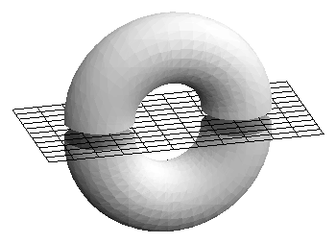
TPP

Slide 27
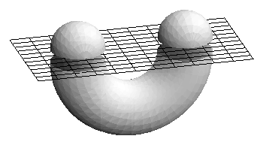
Not TPP

Slide 28
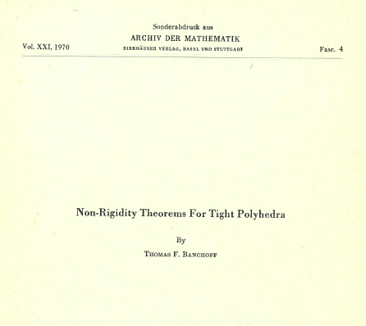

Slide 29
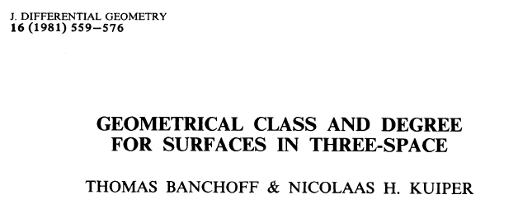

Slide 30
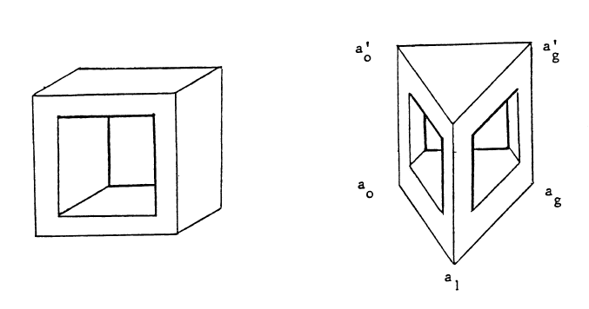

Slide 31
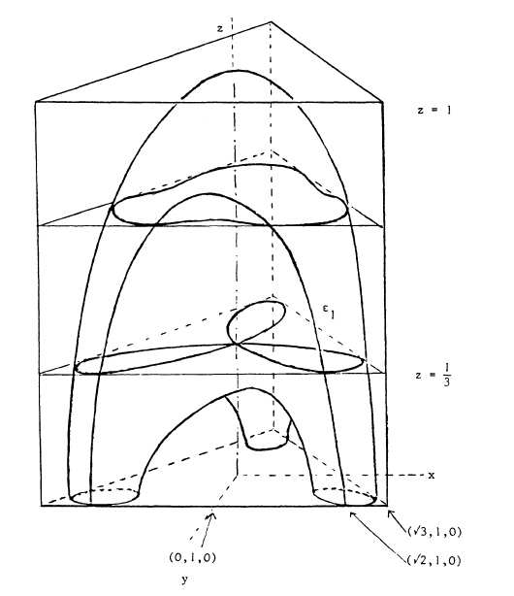

Slide 32
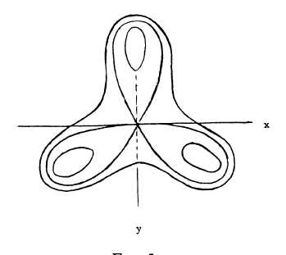

Slide 33
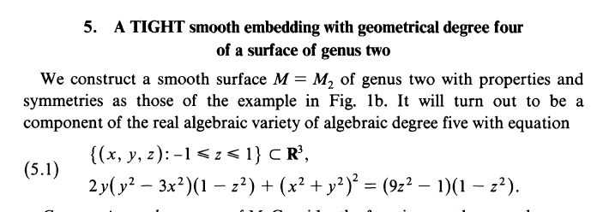

Slide 34
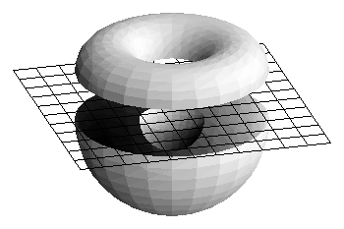
Not TPP

Slide 35
The Spherical Two Piece Property (STPP)
A set X in Euclidean space has the STPP if every sphere S separates X into at most two pieces.
If X is connected, then X has the STPP if and only if the intersection of X with any closed ball or closed ball complement is connected.

Slide 36
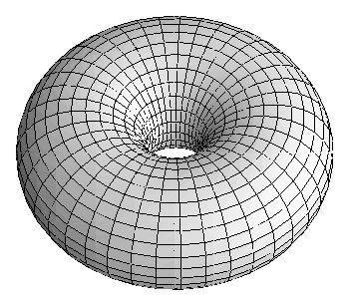
Spherical TPP

Slide 37
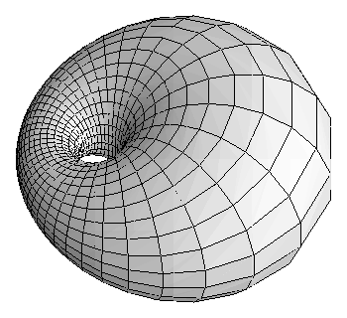
Spherical TPP

Slide 38
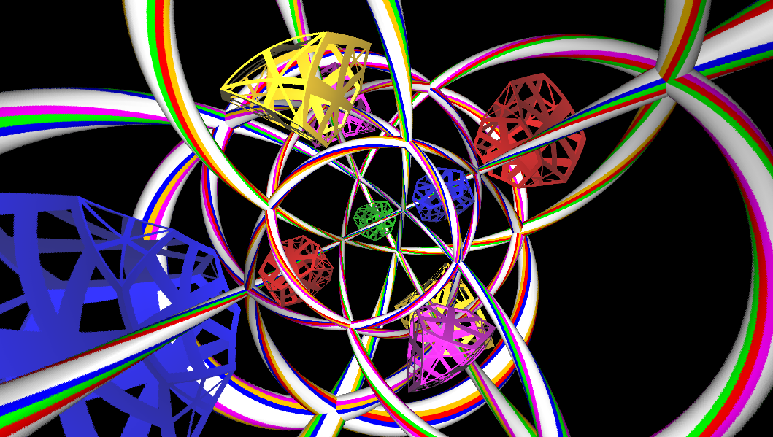
Polar Axes for the 10-Cell Ornament

